Slide 1
Step 1: Identify the most at-risk regions
Corn in North America
Baseline: XX% of growing areas experience high risk, primarily due to [risk factor]
Do nothing: an additional xx% of growing areas will experience high risk due to worse [risk factor]
Input screenshot from the tool
______overall risk
Baseline scenario
Step 2: Prioritize resilience practices
What are the top 5 adaptive practices to improve crop resilience to climate change?
…
Input screenshot from the tool
Do nothing scenario
Step 3: Brainstorm engagement plan
How will you bring your suppliers on board?
Who are the critical stakeholders that must be engaged for success?
What incentives can enhance adherence to the resilience and mitigation plans?
What support can you provide for planning and implementing changes?
…
Input screenshot from the tool
Resilient scenario
Step 4: Next step
What immediate steps need to be taken in the next 6-12 mos?
…

Slide 2
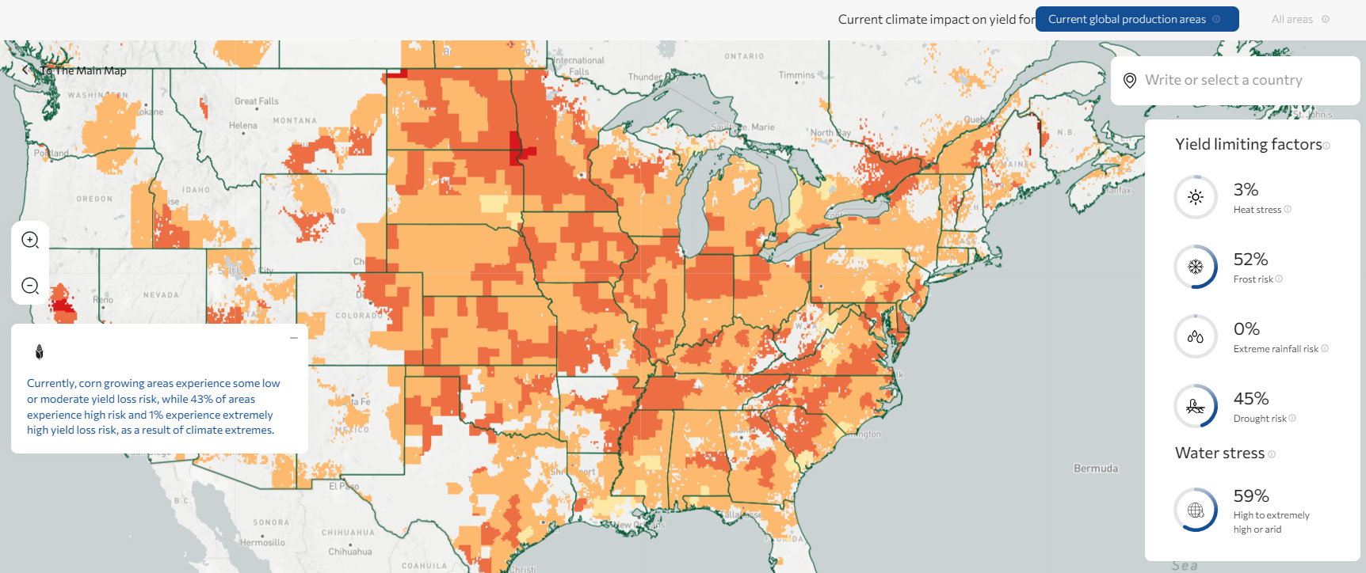
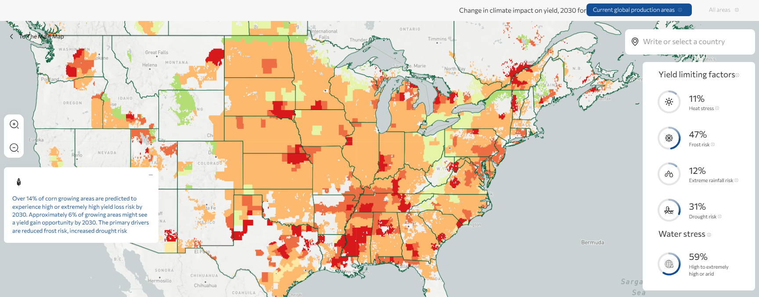
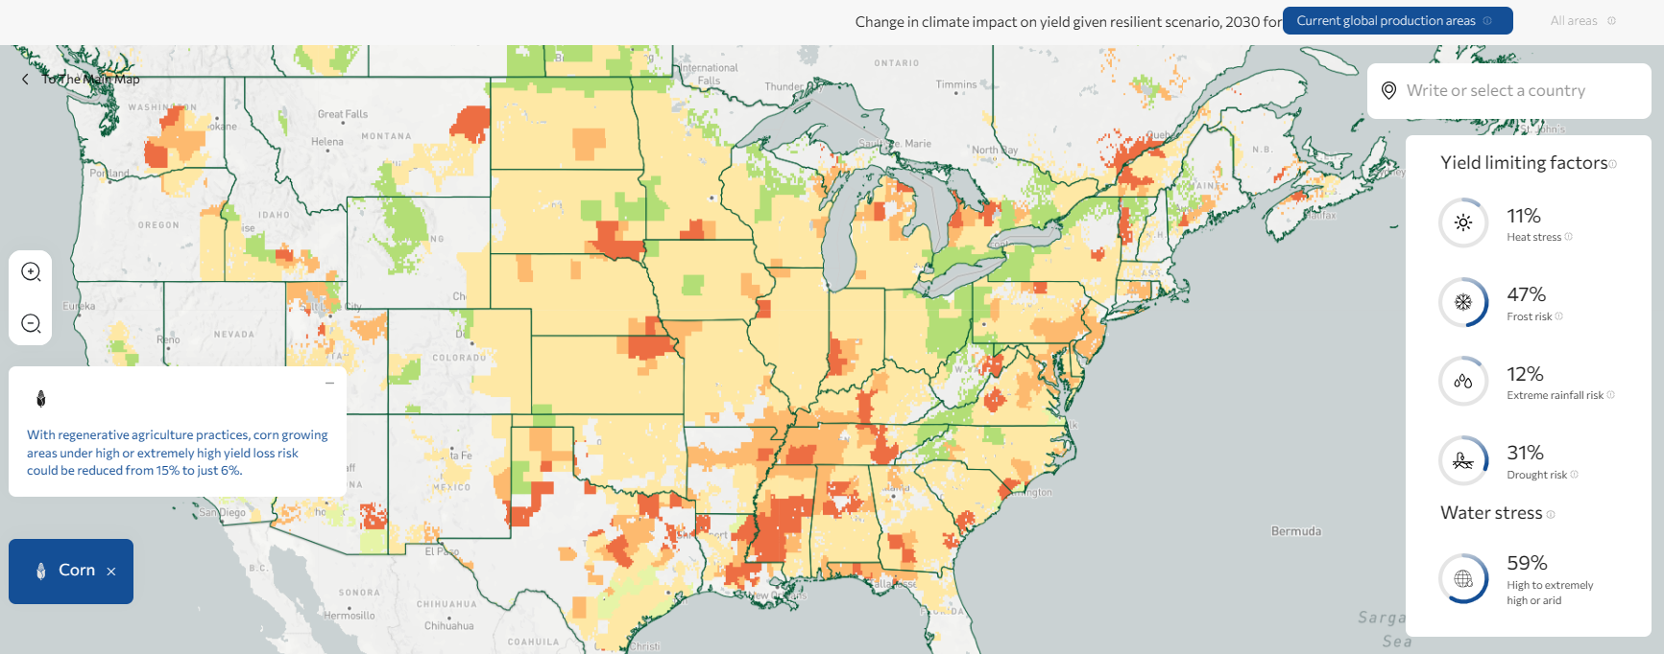
Step 1: Identify the most at-risk regions
Corn in North America
Baseline: 48% of growing areas already experience high risk, primarily from Drought
Do nothing: an additional 14% of growing areas will experience high risk due to worse Drought
Medium to high yield loss risk overall
Baseline scenario
Step 2: Prioritize resilience practices
What are the top 5 adaptive practices to improve crop resilience to climate change?
1. Cover crops
2. Crop rotation
3. Adjusting planting dates
4. Mulching
5. Variety selection
Input screenshot from the tool
Step 3: Brainstorm engagement plan
How will you bring your suppliers on board?
Who are the critical stakeholders that must be engaged for success?
What incentives can enhance adherence to the resilience and mitigation plans?
What support can you provide for planning and implementing changes?
Focus on growing areas in Nebraska and Illinois
Discuss with suppliers on how exposed they are to drought (details on current mitigation plans, farmers’ capacity, investment programs)
Get aligned on top 3-5 practices
Conduct webinars to get all Nebraska and Illinois suppliers on board
Involve local agricultural departments
Offer consultancy and training services to help suppliers adopt new practices
Do nothing scenario
Input screenshot from the tool
Resilient scenario
Step 4: Next step
What immediate steps need to be taken in the next 6-12 mos?
One-on-one meetings with Nebraska and Illinois suppliers to get aligned and get feedback
Reach out to Nebraska Extension

